Slide 1
National Agency of Ukraine
on Civil Service
Functional Analysis of Public Institutions
In the Framework of the
Public Administration Reform
Kyrylo YURCHENKO
Center for Adaptation of the Civil Service
to the Standards of the European Union
Tbilisi, 20 April 2018

Slide 2
National Agency of Ukraine
1
on Civil Service
Organizational changes begin from the functional analysis
Oleksandr SAIENKO
Minister of the Cabinet of Ministers of Ukraine

Slide 3
National Agency of Ukraine
2
on Civil Service
Key
Issues
The system of central executive authorities
Typology of government functions
Goal, typology and tasks
Algorithm
Experience of 2006-2012 and results
Functional analysis as an instrument for public administration reform for 2016-2020
First results

Slide 4
National Agency of Ukraine
3
on Civil Service
The system of central executive authorities
CENTRAL EXECUTIVE AUTHORITIES 66
Ministries 18
Agencies 16
Services 21
Inspections 4
Other 7

Slide 5
National Agency of Ukraine
4
on Civil Service
Ministry
Policy Formation
Public Service
Service Delivery
State Agency
Objects managemant
State inspection
Control functions
Typology of the state functions
conflict

Slide 6
National Agency of Ukraine
5
on Civil Service
Goal, typology and tasks
Goal – to establish the level of correlation of priorities of state policy with the performed functions
Typology
Horizontal analysis
Vertical analysis
Tasks
Streamlining of the system
Rational unification of functions
Optimization of the number
Formation of the register of functions
Optimization of structure
Improving the quality of functions
Optimization of the number
Process Optimization

Slide 7
National Agency of Ukraine
6
on Civil Service
Algorithm
Monitoring, coordination, support are necessary at all stages of the functional analysis
Stage 1. Preparation
Stage 2. General
Stage 3. Final
definition of tasks and terms of FA
formation of the list of documents
preparation of the draft political decision
preparation of IT instruments
Creation of working groups in Central Executive Authorities
collection and analysis of information
road map development
implementation of decisions: organizational, personnel changes
Process Updates

Slide 8
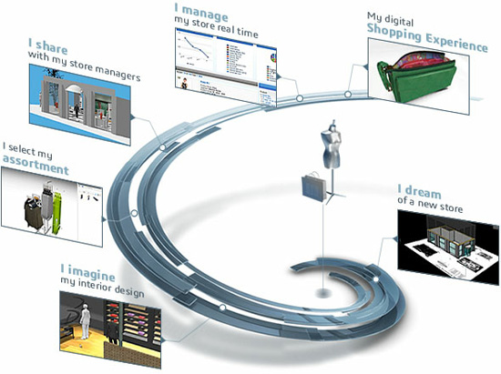
National Agency of Ukraine
7
on Civil Service
Experience
2006-2007 – systemic problems of functioning of central executive authorities were defined;
2008-2009 – register of state functions and proposal to optimize the system of central executive authorities were formed;
2010 – proposals to update the distribution of powers between the territorial bodies of the Central Executive Authorities and the structural subdivisions of Local State Administrations were prepared;
2011 – plans of the institutional reform were prepared;
2012 – proposals for distinction of conflicting types of functions;
2016-2020 – transfer of nonrelevant functions of ministries, the establishment of analytical centers (directorates), the establishment of the institution of the Reform Staff Positions

Slide 9
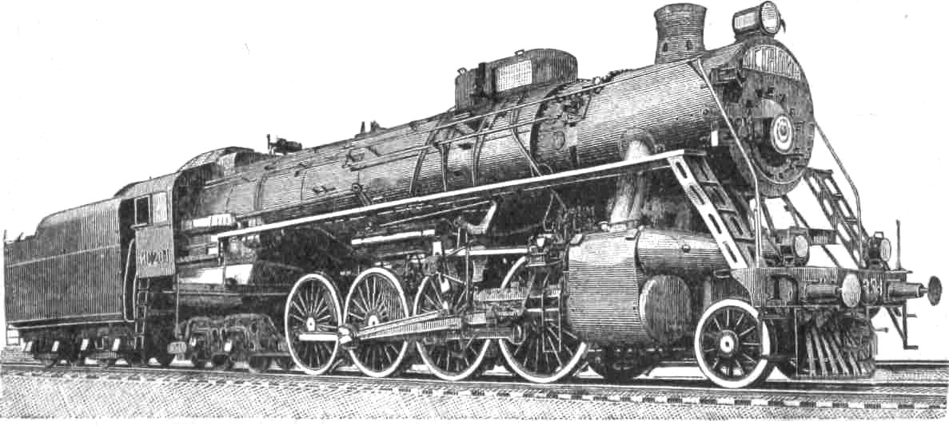
National Agency of Ukraine
8
on Civil Service
Public Administration Reform 2016-2020:
European reference points
Low level of the State Policy
Lack of highly skilled staff
Low level of work of basic electronic resources
Current model
Decision-making process based on policy analysis
Effective Ministries – drivers of reforms
The Secretariat of the CMU – powerful center of the Government
Modern methods of personnel management for the civil service development
Quality administrative services
New model

Slide 10
National Agency of Ukraine
9
on Civil Service
Public Administration Reform for 2016-2020:
Functional Analysis 2016-2018:
Identification of the mission of ministries and general directorates
Updating the list of policies for which the ministry is responsible
Forming the list of functions of General Directorates
Rationalization of the distribution of functions inside the ministry
Cleansing of duplicate, redundant, nonrelevant functions
Preparation of proposals for a new structure of the ministry apparatus.

Slide 11
National Agency of Ukraine
10
on Civil Service
Public Administration Reform for 2016-2020:
Functional Analysis 2016-2020:
First stage: 2016-2018
9 ministries + Secretariat of the Cabinet of Ministers of Ukraine
Second stage: 2018-2020
all other ministries

Slide 12
National Agency of Ukraine
11
on Civil Service
Public Administration Reform for 2016-2020:
Structure of the Ministry 2018
Minister
Deputy Minister
Deputy Minister
Policy
Civil Service professional activity)
State Secretary
Department of Strategic Planning, Policy Coordination and European Integration
Directorate General 1
Directorate General 2
Secretariat of the ministry
Ensuring the work of the ministry
Expert group 1
Expert group 1
Human resource management
Work flow
Expert group 2
Expert group 2
Legal service

Slide 13
National Agency of Ukraine
12
on Civil Service
Public Administration Reform for 2016-2020:
Road Map of the ministries optimization
Organizations changes
Growth of staff capacity
Updating of processes
Directorates General have been established
Unified units on strategic planning, policy coordination, and eurointegration have been established
New provisions have been developed
Competitions
new job profiles have been created
competition procedure has been updated
Involvement of the external HR
Salary
competitive salary level have been established
Trainings
unified training program
trainings on policy-making methods
Political decisions based on policy analysis
Implementation of the electronic work flow system
Paperless exchange of information between ministries
Implementation of strategic planning

Slide 14
National Agency of Ukraine
13
on Civil Service
Contacts
Web site:
http://nads.gov.ua
http://www.center.gov.ua

Slide 15
National Agency of Ukraine
on Civil Service
Thank you for the attention!
Kyrylo YURCHENKO
Center for Adaptation of the Civil Service
to the Standards of the European Union
Tbilisi, 20 April 2018

